Slide 1

Fractals in Seeded TA
Authors: Asher Haun, Ryan Knobel, Adrian Salinas, Ramiro Santos, Robert Schweller, Timothy Wylie

Slide 2
Discrete Self-Similar Fractals
What are they?

Slide 3
Generator
d
c

Slide 4
Generator
Connected

Slide 5
Generator
Connected
Feasible

Slide 6
Generator
Connected
Feasible

Slide 7
Generator
Connected
Feasible

Slide 8
Generator
Connected
Feasible

Slide 9
Generator
Connected
Feasible

Slide 10
Generator
Connected
Feasible

Slide 11
Generator
Connected
Feasible

Slide 12
Generator
Connected
Feasible

Slide 13
Generator
Connected
Feasible

Slide 14
Generator
Connected
Feasible

Slide 15
Generator
Connected
Feasible

Slide 16
Generator
Connected
Feasible

Slide 17
Generator
Connected
Feasible

Slide 18
Generator
Connected
Feasible

Slide 19
Generator
Connected
Feasible

Slide 20
Generator
Connected
Feasible

Slide 21
Discrete Self-Similar Fractal
Stage 1

Slide 22
Discrete Self-Similar Fractal
Stage 1

Slide 23
Discrete Self-Similar Fractal
Stage 1

Slide 24
Discrete Self-Similar Fractal
Stage 1

Slide 25
Discrete Self-Similar Fractal
Stage 1

Slide 26
Discrete Self-Similar Fractal
Stage 1

Slide 27
Discrete Self-Similar Fractal
Stage 1

Slide 28
Discrete Self-Similar Fractal
Stage 1
Stage 2

Slide 29
Discrete Self-Similar Fractal

Slide 30
Discrete Self-Similar Fractal
Strict!
Stage 3

Slide 31
Discrete Self-Similar Fractal

Slide 32
Discrete Self-Similar Fractal
Weak!

Slide 33
Previous Work
Why is this important?

Slide 34
Tile Self-Assembly
Tiles:
A
B
C

Slide 35
Tile Self-Assembly
Tiles:
A
A
B
B
C

Slide 36
Tile Self-Assembly
Tiles:
A
A
B
B
C

Slide 37
Tile Self-Assembly
Tiles:
A
A
B
B
C
C

Slide 38
Tile Self-Assembly
Tiles:
A
A
B
C
B
C

Slide 39
Tile Self-Assembly
Tiles:
System:
A
B
C
Affinities:
A
B
C
A
B
B
B
A
C

Slide 40
Tile Self-Assembly
Tiles:
System:
A
B
C
A
Affinities:
A
B
C
A
B
B
B
A
C

Slide 41
Tile Self-Assembly
Tiles:
System:
A
B
C
Affinities:
A
B
A
C
A
B
B
B
A
C

Slide 42
Tile Self-Assembly
Tiles:
System:
A
B
C
Affinities:
A
B
A
C
A
B
B
B
B
A
C

Slide 43
Tile Self-Assembly
Tiles:
System:
A
B
C
Affinities:
A
B
A
B
C
A
B
B
B
A
C

Slide 44
Tile Self-Assembly
Tiles:
System:
A
B
C
Affinities:
A
B
A
B
C
A
B
B
C
B
A
C

Slide 45
Tile Self-Assembly
Tiles:
System:
A
B
C
Affinities:
A
B
A
B
C
C
A
B
B
B
A
C

Slide 46

The aTAM (abstract Tile Assembly Model)
Tiles:
System:
A
B
C
Affinities:
A
B
A
B
Temperature: $τ$
C
C
A
B
B
B
A
C

Slide 47
The aTAM (abstract Tile Assembly Model)
Tiles:
System:
A
B
C
A
Affinities:
A
B
A
B
Temperature: $τ$
C
C
A
B
B
C
B
A
C
B

Slide 48
The aTAM (abstract Tile Assembly Model)
Tiles:
System:
A
B
C
Affinities:
A
B
A
B
A
B
Temperature: $τ$
C
C
C
A
B
B
B
A
C

Slide 49
The aTAM (abstract Tile Assembly Model)
Tiles:
System:
A
B
C
Affinities:
A
B
A
B
A
B
A
B
A
B
A
B
A
Temperature: $τ$
C
C
C
C
C
C
A
B
B
B
A
C

Slide 50
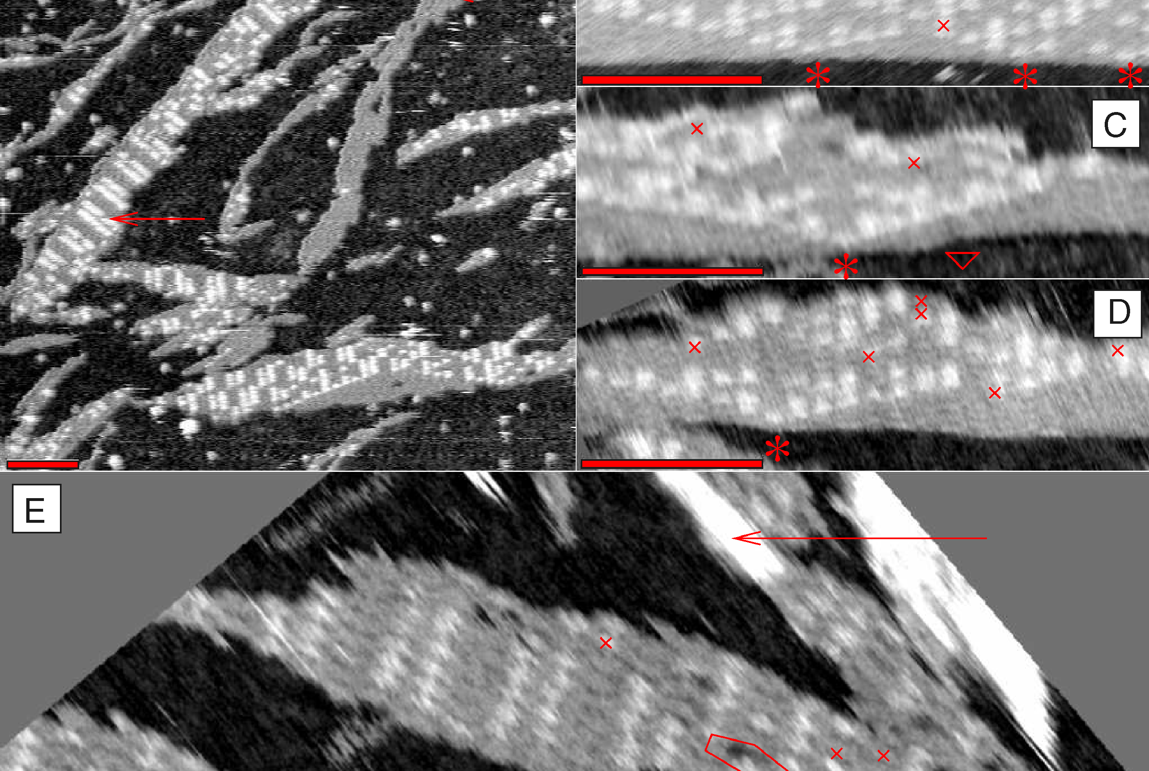
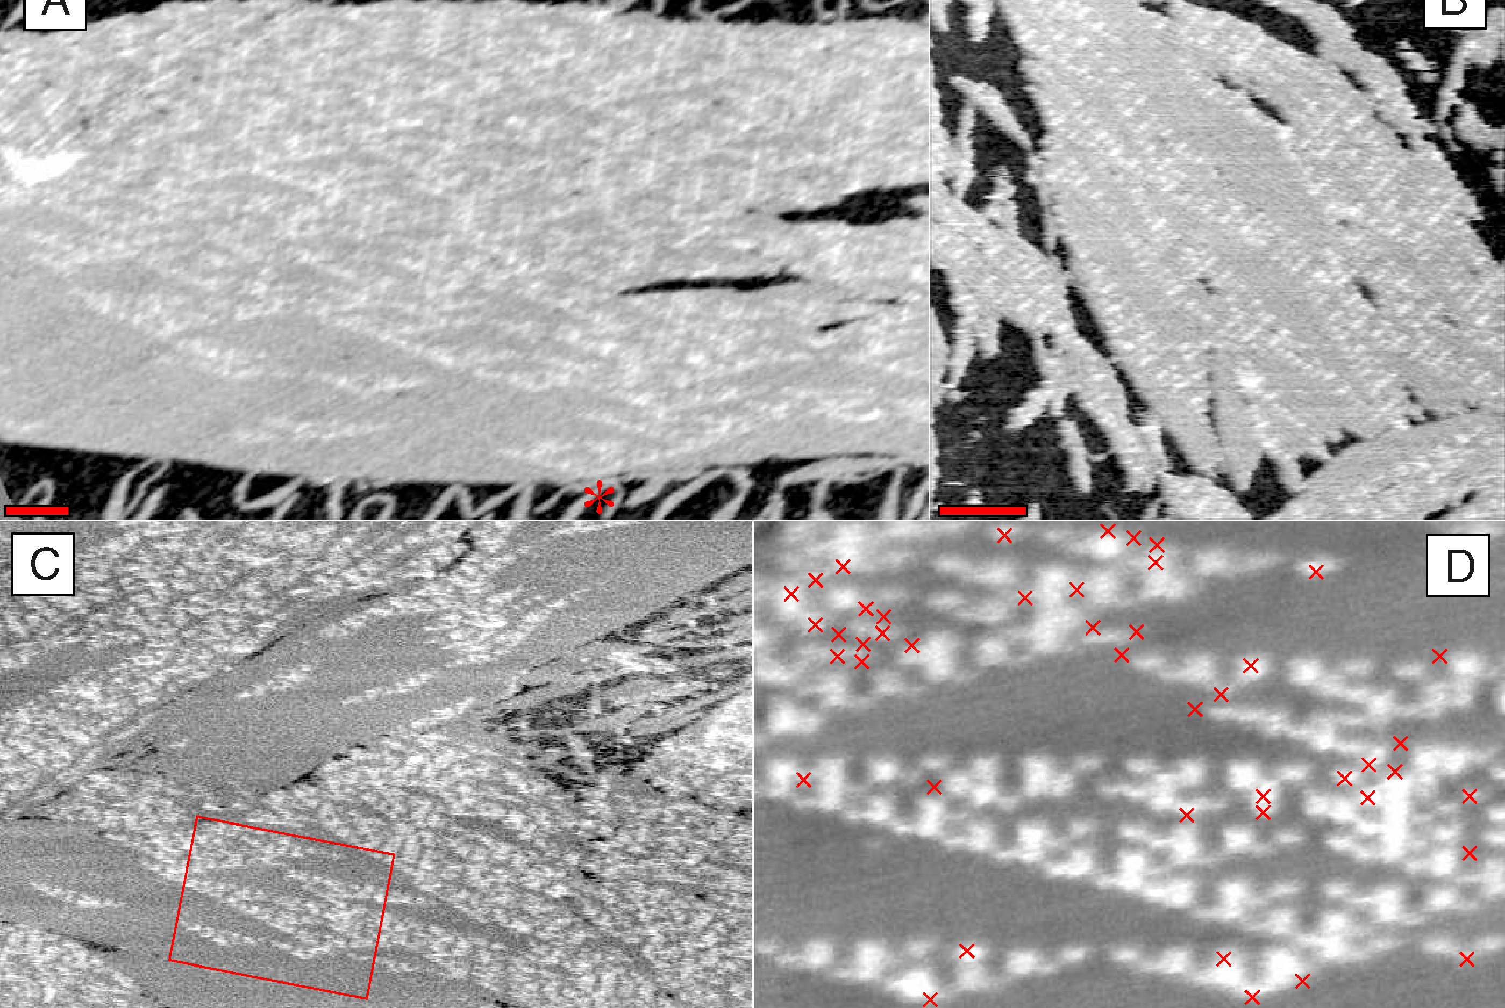
What is known (aTAM)
Rothemund PWK, Papadakis N, Winfree E (2004) Algorithmic Self-Assembly of DNA Sierpinski Triangles. PLoS Biol 2(12): e424.

Slide 51
What is known (aTAM)
2010 [M. J. Patitz, S. M. Summers. Self-assembly of discrete self-similar fractals]:
Any “L” shape does not strictly self assemble in the aTAM (any temp)
No fractal weakly self assembles at temperature 1
“Nice” fractals can be weakly self assembled at higher temps
2025 [F. Becker, D. Hader, M. J. Patitz. Strict self-assembly of discrete self-similar fractals in the abstract tile-assembly model]:
A full characterization of which DSSFs are buildable in the aTAM.

Slide 52
Variations of the aTAM
2HAM (2-Handed Assembly Model):
2 different assemblies can attach
Can finitely assemble a larger class of shapes
STAM (Signal-Passing Tile Assembly Model):
Glues can turn “on” and “off”
Detachment is allowed

Slide 53
Variations of the aTAM
2HAM (2-Handed Assembly Model):
2 different assemblies can attach
Can finitely assemble a larger class of shapes
STAM (Signal-Passing Tile Assembly Model):
Glues can turn “on” and “off”
Detachment is allowed
Any arbitrary fractal is buildable
Without detachments, some shapes impossible

Slide 54
A Comparison
 | aTAM | 2HAM | STAM
Description | Single tile attachments No detachments Fixed glues | Up to 2 assembly attachments No detachments Fixed glues | Up to 2 assembly attachments Detachments Glues turn on/off
Results | No fractals weakly buildable (temp 1) Some fractals not strictly buildable (temp > 1) | Finitely assemble larger class of shapes Still some non-buildable fractals | All fractals strictly buildable Without detachment: some impossible fractals
Question: What if adjacent tiles can infinitely change states?

Slide 55
Seeded Tile Automata
What is the model?

Slide 56
Seeded TA
Tiles:
System:
A
A
B
C
B
A
Affinities:
A
A
Temperature: $τ$
C
B
B
B
A
B
B
B
A
C
B
C
A

Slide 57
Seeded TA
Tiles:
System:
A
A
B
C
B
A
Affinities:
A
A
Temperature: $τ$
C
B
B
B
A
B
B
C
B
A
C
B
A

Slide 58
Seeded TA
Tiles:
System:
A
A
B
C
B
A
Affinities:
A
A
Temperature: $τ$
B
B
B
A
B
B
C
C
B
A
C
B
A

Slide 59
Seeded TA
Tiles:
System:
A
A
B
C
B
A
Affinities:
A
A
Temperature: $τ$
B
B
B
A
A
B
B
C
C
B
A
C
B

Slide 60
Seeded TA
Tiles:
System:
A
B
C
Affinities:
A
A
B
A
B
Temperature: $τ$
B
B
A
B
A
A
B
B
C
C
B
A
C

Slide 61
Seeded TA
Transitions:
System:
A
B
C
C
Affinities:
A
A
B
A
B
Temperature: $τ$
B
B
A
B
A
A
B
B
C
C
B
A
C

Slide 62
Seeded TA
Transitions:
System:
A
B
C
C
Affinities:
A
C
C
A
B
Temperature: $τ$
B
B
A
B
A
A
B
B
C
C
B
A
C

Slide 63
Seeded TA
Transitions:
System:
A
B
C
C
Affinities:
A
C
C
A
B
Temperature: $τ$
B
B
C
C
A
A
B
B
C
C
B
A
C

Slide 64
Seeded TA
Transitions:
System:
A
B
C
C
Affinities:
A
C
C
C
C
Temperature: $τ$
B
B
C
C
A
A
B
B
C
C
B
A
C

Slide 65
What is known
 | aTAM | 2HAM | STAM | Seeded TA
Description | Single tile attachments No detachments Fixed glues | Up to 2 assembly attachments No detachments Fixed glues | Up to 2 assembly attachments Detachments Glues turn on/off | Single tile attachments No detachments Transitions
Results | No fractals weakly buildable (temp 1) Some fractals not strictly buildable (temp > 1) | Finitely assemble larger class of shapes Still some non-buildable fractals | All fractals strictly buildable Without detachment: some impossible fractals | Fractals with generators that have a Ham-path are strictly buildable (temp 1)

Slide 66
Our Contribution
 | aTAM | 2HAM | STAM | Seeded TA
Description | Single tile attachments No detachments Fixed glues | Up to 2 assembly attachments No detachments Fixed glues | Up to 2 assembly attachments Detachments Glues turn on/off | Single tile attachments No detachments Transitions
Results | No fractals weakly buildable (temp 1) Some fractals not strictly buildable (temp > 1) | Finitely assemble larger class of shapes Still some non-buildable fractals | All fractals strictly buildable Without detachment: some impossible fractals | Fractals with generators that have a Ham-path are strictly buildable (temp 1)

Slide 67
Our Contribution
 | aTAM | 2HAM | STAM | Seeded TA
Description | Single tile attachments No detachments Fixed glues | Up to 2 assembly attachments No detachments Fixed glues | Up to 2 assembly attachments Detachments Glues turn on/off | Single tile attachments No detachments Transitions
Results | No fractals weakly buildable (temp 1) Some fractals not strictly buildable (temp > 1) | Finitely assemble larger class of shapes Still some non-buildable fractals | All fractals strictly buildable Without detachment: some impossible fractals | ALL fractals are strictly buildable (temp 1) There exists a single system that does so

Slide 68
The Construction
How did we do it?

Slide 69
Important Observation
Generators

Slide 70
Important Observation
Generator

Slide 71
Important Observation
Generator

Slide 72
Important Observation
Generator

Slide 73
Important Observation
…
Generator

Slide 74
High Level Idea

Slide 75
High Level Idea

Slide 76
High Level Idea

Slide 77
High Level Idea

Slide 78
Step 1: Devising an Order

Slide 79
Step 1: Devising an Order

Slide 80
Step 2: A Copying Procedure

Slide 81
Step 2: A Copying Procedure

Slide 82
Step 2: A Copying Procedure

Slide 83
Step 2: A Copying Procedure

Slide 84
Step 2: A Copying Procedure

Slide 85
Step 2: A Copying Procedure

Slide 86
Step 2: A Copying Procedure

Slide 87
Step 2: A Copying Procedure

Slide 88
Step 2: A Copying Procedure

Slide 89
Step 2: A Copying Procedure

Slide 90
Step 2: A Copying Procedure

Slide 91
Step 2: A Copying Procedure

Slide 92
Step 2: A Copying Procedure

Slide 93
Step 2: A Copying Procedure

Slide 94
Step 2: A Copying Procedure

Slide 95
Step 2: A Copying Procedure

Slide 96
Step 2: A Copying Procedure

Slide 97
Step 2: A Copying Procedure

Slide 98
Step 2: A Copying Procedure

Slide 99
Step 2: A Copying Procedure

Slide 100
Step 2: A Copying Procedure

Slide 101
Step 2: A Copying Procedure

Slide 102
Step 2: A Copying Procedure

Slide 103
Step 2: A Copying Procedure

Slide 104
Step 2: A Copying Procedure

Slide 105
Step 2: A Copying Procedure

Slide 106
Step 2: A Copying Procedure

Slide 107
Step 2: A Copying Procedure

Slide 108
Step 2: A Copying Procedure

Slide 109
Step 3: Growing the Full Assembly

Slide 110
Step 3: Growing the Full Assembly

Slide 111
Step 3: Growing the Full Assembly

Slide 112
Step 3: Growing the Full Assembly

Slide 113
Step 3: Growing the Full Assembly

Slide 114
Step 3: Growing the Full Assembly

Slide 115
Step 3: Growing the Full Assembly

Slide 116
Step 3: Growing the Full Assembly

Slide 117
Step 3: Growing the Full Assembly

Slide 118
Step 3: Growing the Full Assembly

Slide 119
Step 3: Growing the Full Assembly

Slide 120
Step 3: Growing the Full Assembly

Slide 121
Step 4: Resetting

Slide 122
Step 4: Resetting

Slide 123
Step 4: Resetting

Slide 124
Step 4: Resetting

Slide 125
Step 4: Resetting

Slide 126
Step 4: Resetting

Slide 127
Step 4: Resetting

Slide 128
Step 4: Resetting

Slide 129
Step 4: Resetting

Slide 130
Synchronization

Slide 131
Synchronization

Slide 132
Synchronization

Slide 133
Synchronization

Slide 134
Synchronization

Slide 135
Synchronization

Slide 136
Synchronization

Slide 137
Synchronization

Slide 138
Synchronization

Slide 139
Synchronization

Slide 140
Synchronization
2

Slide 141
Synchronization
2

Slide 142
Synchronization
3

Slide 143
Synchronization
4

Slide 144
Synchronization

Slide 145
Synchronization

Slide 146
Synchronization

Slide 147
Synchronization

Slide 148
Final Result (Sierpinski Triangle)

Slide 149
Conclusion
What is left?

Slide 150
Conclusion
All fractals are buildable at temperature 1
A single system exists that builds all these fractals
Do higher temperatures allow for more efficient fractal constructions?
Are there special classes of fractals which can be built with small systems?

Slide 151
Fractals in Seeded TA
Authors: Asher Haun, Ryan Knobel, Adrian Salinas, Ramiro Santos, Robert Schweller, Timothy Wylie

Slide 152
Step 1: A Copying Procedure

Slide 153
Step 1: A Copying Procedure

Slide 154
Step 1: A Copying Procedure

Slide 155
Step 1: A Copying Procedure

Slide 156
Step 1: A Copying Procedure

Slide 157
Step 1: A Copying Procedure

Slide 158
Step 1: A Copying Procedure

Slide 159
Step 1: A Copying Procedure

Slide 160
Step 1: A Copying Procedure

Slide 161
Step 1: A Copying Procedure

Slide 162
Step 1: A Copying Procedure

Slide 163
Step 1: A Copying Procedure

Slide 164
Step 1: A Copying Procedure

Slide 165
Step 1: A Copying Procedure

Slide 166
Step 1: A Copying Procedure

Slide 167
Step 1: A Copying Procedure

Slide 168
Step 1: A Copying Procedure

Slide 169
Step 1: A Copying Procedure

Slide 170
Step 1: A Copying Procedure

Slide 171
Step 1: A Copying Procedure

Slide 172
Step 1: A Copying Procedure

Slide 173
Step 1: A Copying Procedure

Slide 174
Step 1: A Copying Procedure

Slide 175
Step 1: A Copying Procedure

Slide 176
Step 1: A Copying Procedure

Slide 177
Step 1: A Copying Procedure

Slide 178
Step 1: A Copying Procedure

